Slide 1
專題研究進度報告
指導教授：盧奕璋教授
學生：電機三 B05901064 林承德

Slide 2
User Guide
Start
Length of S is unlimited
Length of T ≤ 7168
Match(one of parameters) ≤ 15
Use 256words x 1024 addr sram (32 8x1024 srams)
Set sequence T
Sequence T
Compute
IDLE
Sequence S, parameter
Result

Slide 3
Input Type
Input [127:0] i_s
64 DNA of sequence s, i_s[127:126] represents the former DNA.
Input [6:0] i_s_valid
7’d0 means not valid, 7’b1111111 means there are DNA after i_s.
Other means only the value of i_s are valid.
Input [17:0] i_t
i_t[17] : valid or not
i_t[16:14] :
3’d0 means there are DNAs after i_t
other means only the value of i_t are valud
i_t[13:0] : 7 DNA of sequence, i_t[13:12] represents the former DNA

Slide 4
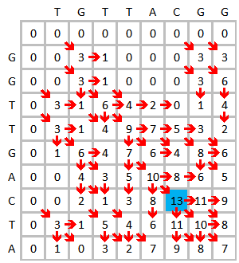



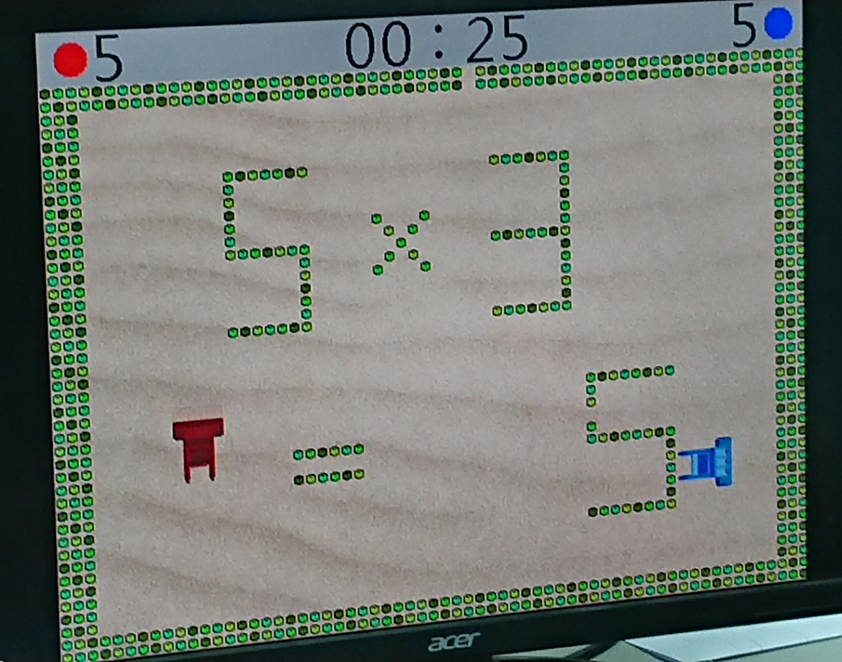

Slide 5
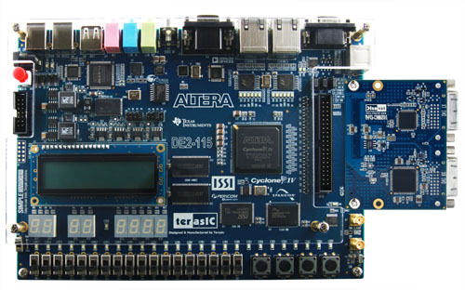
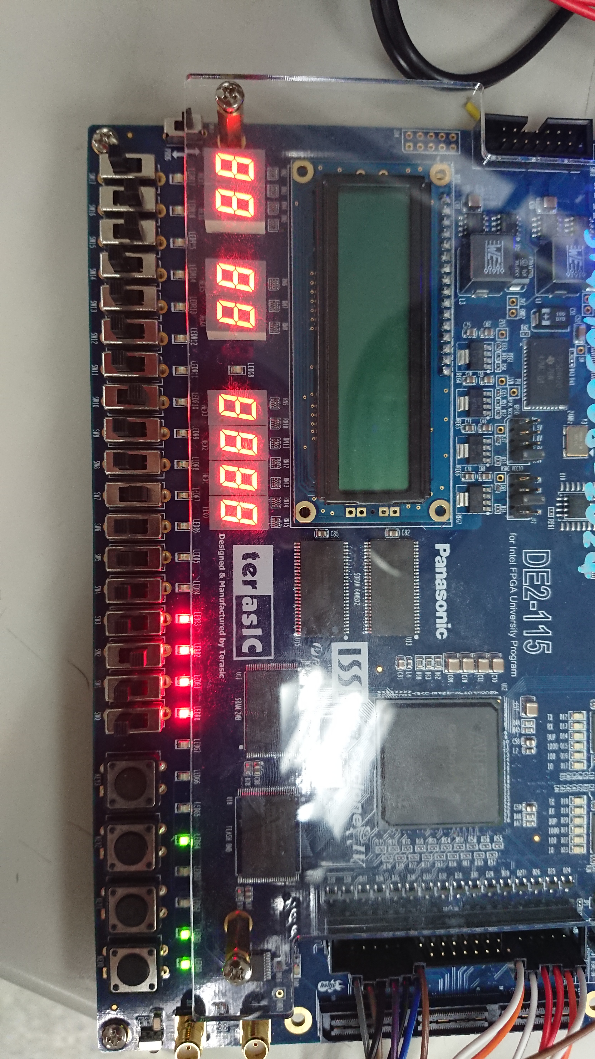
FPGA
Result
LED
State
Start
Set
T
Rst
Match
Mismatch
Alpha
Beta

Slide 6
FPGA
FPGAWrapper
Store the sequences on FPGA
Give data to origin top module
Aware of the delay of input buffer
SystemVerilog v.s. Verilog
Give a name to for loop

Slide 7
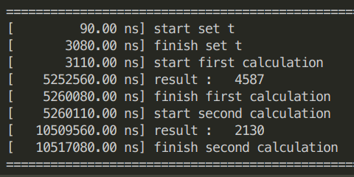
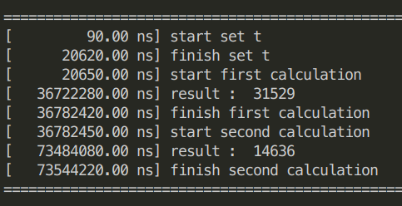
FPGA
16384 x 1024
S | T | set cycle | valid cycle | busy cycle
80 | 80 | 1023 | 203 | 203
256 | 256 | 1023 | 1142 | 1142
512 | 512 | 1023 | 2292 | 2292
1024 | 1024 | 1023 | 16847 | 16847
2048 | 1024 | 1023 | 33247 | 33247
4096 | 1024 | 1023 | 66047 | 66047
8192 | 1024 | 1023 | 131647 | 131647
16384 | 1024 | 1023 | 262847 | 262847
16384 | 7168 | 1023 | 1834497 | 1834497
16384 x 7168

Slide 8
FPGA
Clock cycle = 20ns
S | T | software (s) | hardware(s) | ratio
80 | 80 | 0.002 | 0.00000862 | 232.0186
256 | 256 | 0.007 | 0.00004668 | 149.9572
512 | 512 | 0.013 | 0.0001753 | 74.15859
1024 | 1024 | 0.036 | 0.00067708 | 53.16949
2048 | 1024 | 0.064 | 0.00133308 | 48.00912
4096 | 1024 | 0.12 | 0.00264508 | 45.36725
8192 | 1024 | 0.223 | 0.00526908 | 42.32238
16384 | 1024 | 0.421 | 0.01051708 | 40.03012
16384 | 7168 | 2.726 | 0.07354422 | 37.06614

Slide 9

Gate Level
cycle(ns) | area | AT value | power(mW) | ratio(16384x1024)
10 | 3084412 | 30844123.61 | 32.1701 | 80.60024
8 | 3143204 | 25145628.05 | 40.907 | 100.7503
6 | 3270118 | 19620708.62 | 57.5923 | 134.3337333
Critical Path : PE element
Credit :

Slide 10
Q & A

